Slide 1
CS 1678: Intro to Deep Learning Neural Network Training (Part 2)
Prof. Adriana Kovashka University of Pittsburgh
January 31, 2024

Slide 2
Plan for this lecture
Tricks of the trade
Preprocessing, initialization, normalization
Dealing with limited data
GPUs
Convergence of gradient descent
How long will it take?
Will it work at all?
Different optimization strategies
Alternatives to SGD
Learning rates
Choosing hyperparameters
How to do the computation
Computation graphs
Vector notation (Jacobians)

Slide 3
Tricks of the trade

Slide 4
Practical matters
Getting started: Preprocessing, initialization, normalization, choosing activation functions
Improving performance and dealing with sparse data: regularization, augmentation, transfer learning
Hardware and software
Extra reading/visualization resources
https://www.deeplearning.ai/ai-notes/initialization/
https://www.deeplearning.ai/ai-notes/optimization/

Slide 5
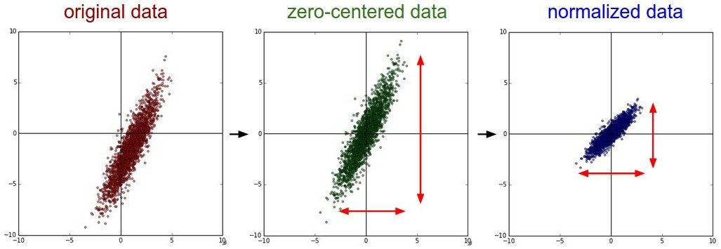
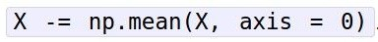
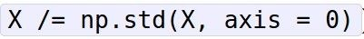
Preprocessing the Data
(Assume X [NxD] is data matrix, each example in a row)
Fei-Fei Li & Justin Johnson & Serena Yeung Lecture 6 - April 19, 2018
Fei-Fei Li, Andrej Karpathy, Justin Johnson, Serena Yeung

Slide 6
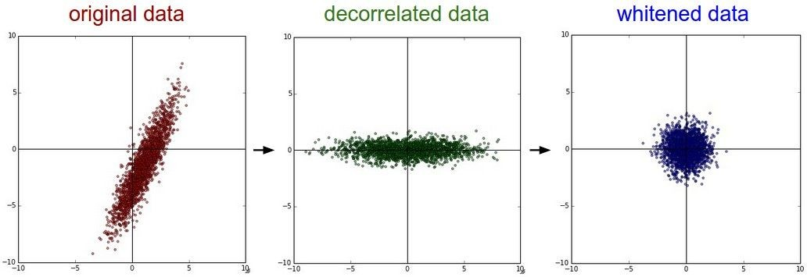
Preprocessing the Data
In practice, you may also see PCA and Whitening of the data
(data has diagonal covariance matrix)
(covariance matrix is the identity matrix)
Lecture 6 - 39
Fei-Fei Li & Justin Johnson & Serena Yeung Lecture 6 - April 19, 2018
Fei-Fei Li, Andrej Karpathy, Justin Johnson, Serena Yeung

Slide 7
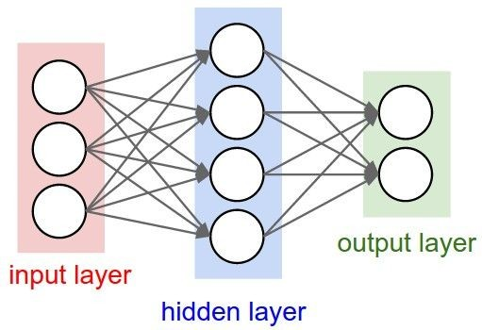
Weight Initialization
Q: what happens when W=constant init is used?
Fei-Fei Li, Andrej Karpathy, Justin Johnson, Serena Yeung

Slide 8
Weight Initialization
- Another idea: Small random numbers
(gaussian with zero mean and 1e-2 standard deviation)
Works ~okay for small networks, but problems with deeper networks.
Fei-Fei Li & Justin Johnson & Serena Yeung Lecture 6 - April 19, 2018
Fei-Fei Li, Andrej Karpathy, Justin Johnson, Serena Yeung

Slide 9
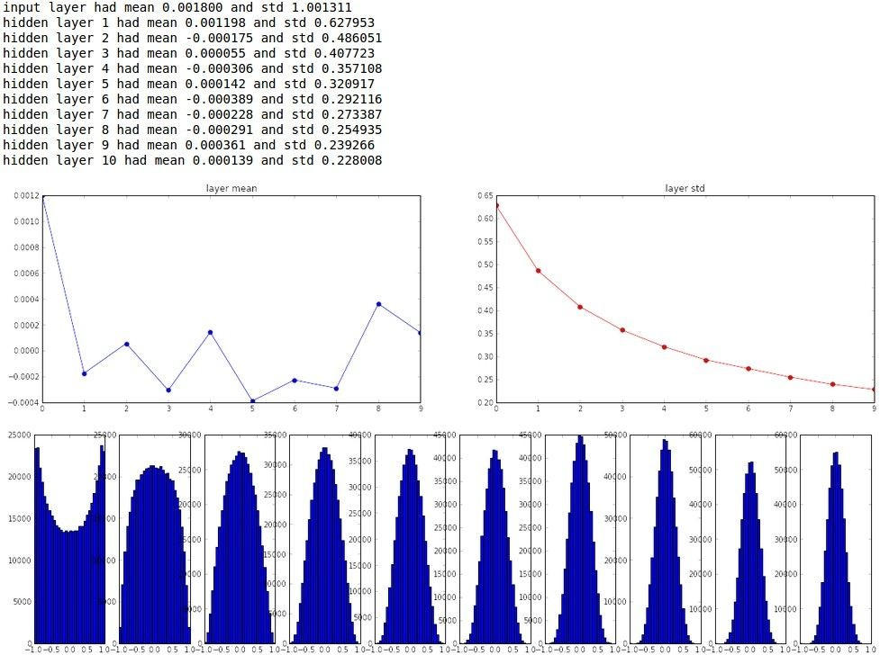
“Xavier initialization” [Glorot et al., 2010]
Reasonable initialization. (Mathematical derivation assumes linear activations)
Fei-Fei Li & Justin Johnson & Serena Yeung Lecture 6 - April 19, 2018
https://www.deeplearning.ai/ai-notes/initialization/#IV
Fei-Fei Li, Andrej Karpathy, Justin Johnson, Serena Yeung

Slide 10
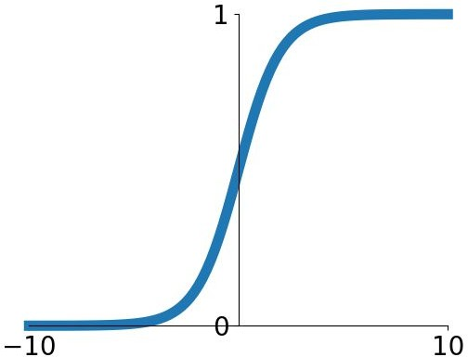
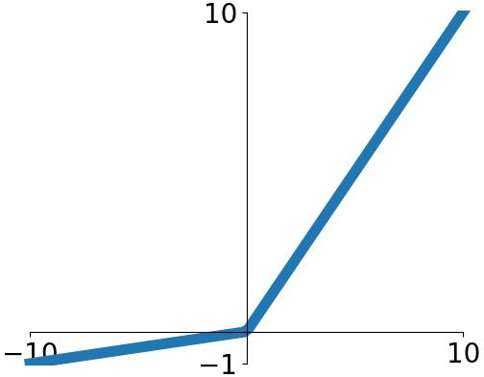
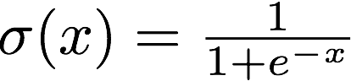
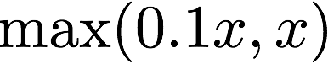
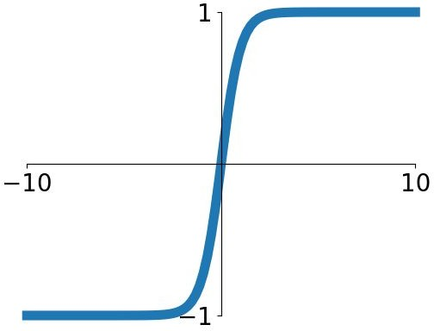
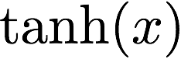
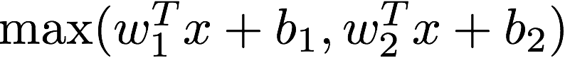
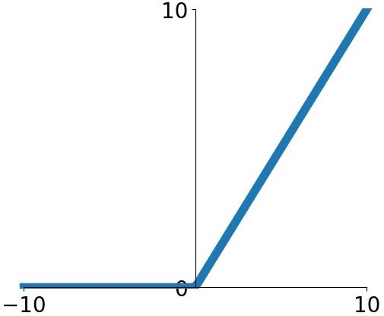
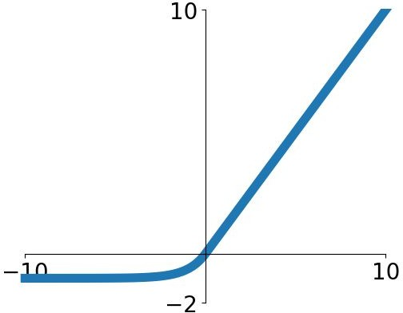
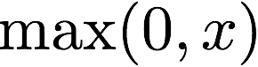
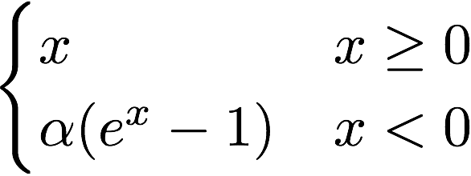
Activation Functions
Sigmoid
tanh
Leaky ReLU
Maxout
ReLU
ELU
Lecture 7 -
Fei-Fei Li & Justin Johnson & Serena Yeung Lecture 7 - April 22, 2019
Fei-Fei Li, Andrej Karpathy, Justin Johnson, Serena Yeung

Slide 11
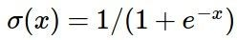
Activation Functions
Squashes numbers to range [0,1]
Historically popular since they have nice interpretation as a saturating “firing rate” of a neuron
Sigmoid
Fei-Fei Li, Andrej Karpathy, Justin Johnson, Serena Yeung

Slide 12
Activation Functions
Squashes numbers to range [0,1]
Historically popular since they have nice interpretation as a saturating “firing rate” of a neuron
3 problems:
1. Saturated neurons “kill” the gradients
Sigmoid
Lecture 7 -
Fei-Fei Li & Justin Johnson & Serena Yeung Lecture 7 - April 22, 2019
Fei-Fei Li, Andrej Karpathy, Justin Johnson, Serena Yeung

Slide 13
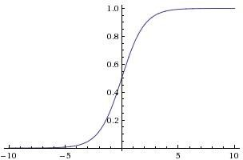
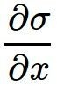
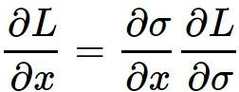
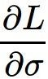
sigmoid gate
x
What happens when x = -10? What happens when x = 0?
What happens when x = 10?
Lecture 7 -
Fei-Fei Li & Justin Johnson & Serena Yeung Lecture 7 - April 22, 2019
Fei-Fei Li, Andrej Karpathy, Justin Johnson, Serena Yeung

Slide 14
Activation Functions
Squashes numbers to range [0,1]
Historically popular since they have nice interpretation as a saturating “firing rate” of a neuron
3 problems:
Saturated neurons “kill” the gradients
Sigmoid outputs are not zero-centered
Sigmoid
Lecture 7 -
Fei-Fei Li & Justin Johnson & Serena Yeung Lecture 7 - April 22, 2019
Fei-Fei Li, Andrej Karpathy, Justin Johnson, Serena Yeung

Slide 15
Activation Functions
Squashes numbers to range [0,1]
Historically popular since they have nice interpretation as a saturating “firing rate” of a neuron
3 problems:
Saturated neurons “kill” the gradients
Sigmoid outputs are not zero-centered
exp() is a bit compute expensive
Sigmoid
Lecture 7 -
Fei-Fei Li & Justin Johnson & Serena Yeung Lecture 7 - April 22, 2019
Fei-Fei Li, Andrej Karpathy, Justin Johnson, Serena Yeung

Slide 16
Activation Functions
Squashes numbers to range [-1,1]
zero centered (nice)
still kills gradients when saturated :(
tanh(x)
[LeCun et al., 1991]
Lecture 7 -
Fei-Fei Li & Justin Johnson & Serena Yeung Lecture 7 - April 22, 2019
Fei-Fei Li, Andrej Karpathy, Justin Johnson, Serena Yeung

Slide 17
- Computes f(x) = max(0,x)
Activation Functions
Does not saturate (in +region)
Very computationally efficient
Converges much faster than sigmoid/tanh in practice (e.g. 6x)
ReLU
(Rectified Linear Unit)
[Krizhevsky et al., 2012]
Lecture 7 -
Fei-Fei Li & Justin Johnson & Serena Yeung Lecture 7 - April 22, 2019
Fei-Fei Li, Andrej Karpathy, Justin Johnson, Serena Yeung

Slide 18
Activation Functions
- Computes f(x) = max(0,x)
Does not saturate (in +region)
Very computationally efficient
Converges much faster than sigmoid/tanh in practice (e.g. 6x)
Not zero-centered output
ReLU
(Rectified Linear Unit)
Lecture 7 -
Fei-Fei Li & Justin Johnson & Serena Yeung Lecture 7 - April 22, 2019
Fei-Fei Li, Andrej Karpathy, Justin Johnson, Serena Yeung

Slide 19
- Computes f(x) = max(0,x)
Activation Functions
Does not saturate (in +region)
Very computationally efficient
Converges much faster than sigmoid/tanh in practice (e.g. 6x)
Not zero-centered output
An annoyance:
hint: what is the gradient when x < 0?
ReLU
(Rectified Linear Unit)
Lecture 7 -
Fei-Fei Li & Justin Johnson & Serena Yeung Lecture 7 - April 22, 2019
Fei-Fei Li, Andrej Karpathy, Justin Johnson, Serena Yeung

Slide 20
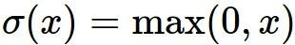
x
ReLU
gate
What happens when x = -10? What happens when x = 0?
What happens when x = 10?
Lecture 7 -
Fei-Fei Li & Justin Johnson & Serena Yeung Lecture 7 - April 22, 2019
Fei-Fei Li, Andrej Karpathy, Justin Johnson, Serena Yeung

Slide 21
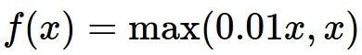
Activation Functions
[Mass et al., 2013] [He et al., 2015]
Does not saturate
Computationally efficient
Converges much faster than sigmoid/tanh in practice! (e.g. 6x)
- will not “die”.
Leaky ReLU
Lecture 7 -
Fei-Fei Li & Justin Johnson & Serena Yeung Lecture 7 - April 22, 2019
Fei-Fei Li, Andrej Karpathy, Justin Johnson, Serena Yeung

Slide 22
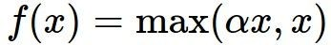
Activation Functions
[Mass et al., 2013] [He et al., 2015]
Does not saturate
Computationally efficient
Converges much faster than sigmoid/tanh in practice! (e.g. 6x)
- will not “die”.
Parametric Rectifier (PReLU)
Leaky ReLU
backprop into alpha (parameter)
Lecture 7 -
Fei-Fei Li & Justin Johnson & Serena Yeung Lecture 7 - April 22, 2019
Fei-Fei Li, Andrej Karpathy, Justin Johnson, Serena Yeung

Slide 23
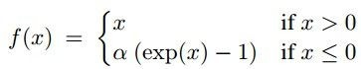
Activation Functions
[Clevert et al., 2015]
Exponential Linear Units (ELU)
- All benefits of ReLU
Closer to zero mean outputs
Negative saturation regime compared with Leaky ReLU adds some robustness to noise
Computation requires exp()
Lecture 7 -
Fei-Fei Li & Justin Johnson & Serena Yeung Lecture 7 - April 22, 2019
Fei-Fei Li, Andrej Karpathy, Justin Johnson, Serena Yeung

Slide 24
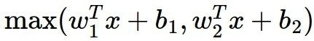
Maxout “Neuron”
[Goodfellow et al., 2013]
Does not have the basic form of dot product -> nonlinearity
Generalizes ReLU and Leaky ReLU
Linear Regime! Does not saturate! Does not die!
Problem: doubles the number of parameters/neuron :(
Lecture 7 -
Fei-Fei Li & Justin Johnson & Serena Yeung Lecture 7 - April 22, 2019
Fei-Fei Li, Andrej Karpathy, Justin Johnson, Serena Yeung

Slide 25
TLDR: In practice:
Use ReLU. Be careful with your learning rates
Try out Leaky ReLU / Maxout / ELU / PReLU
Try out tanh but don’t expect much
Don’t use sigmoid
Lecture 7 -
Fei-Fei Li & Justin Johnson & Serena Yeung Lecture 7 - April 22, 2019
Adapted from Fei-Fei Li, Andrej Karpathy, Justin Johnson, Serena Yeung

Slide 26
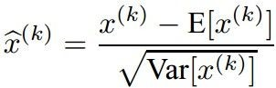
Batch Normalization
[Ioffe and Szegedy, 2015]
“you want zero-mean unit-variance activations? just make them so.”
consider a batch of activations at some layer. To make each dimension zero-mean unit-variance, apply:
Fei-Fei Li & Justin Johnson & Serena Yeung Lecture 6 - April 19, 2018
Fei-Fei Li, Andrej Karpathy, Justin Johnson, Serena Yeung

Slide 27


Batch Normalization
[Ioffe and Szegedy, 2015]
“you want zero-mean unit-variance activations? just make them so.”
1. compute the empirical mean and variance independently for each dimension.
N
2. Normalize
D
Fei-Fei Li & Justin Johnson & Serena Yeung Lecture 6 - April 19, 2018
Fei-Fei Li, Andrej Karpathy, Justin Johnson, Serena Yeung

Slide 28
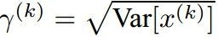
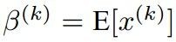
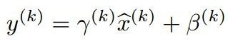
Batch Normalization
[Ioffe and Szegedy, 2015]
Normalize:
Note, the network can learn:
to recover the identity mapping.
And then allow the network to squash the range if it wants to:
Fei-Fei Li & Justin Johnson & Serena Yeung Lecture 6 - April 19, 2018
Fei-Fei Li, Andrej Karpathy, Justin Johnson, Serena Yeung

Slide 29
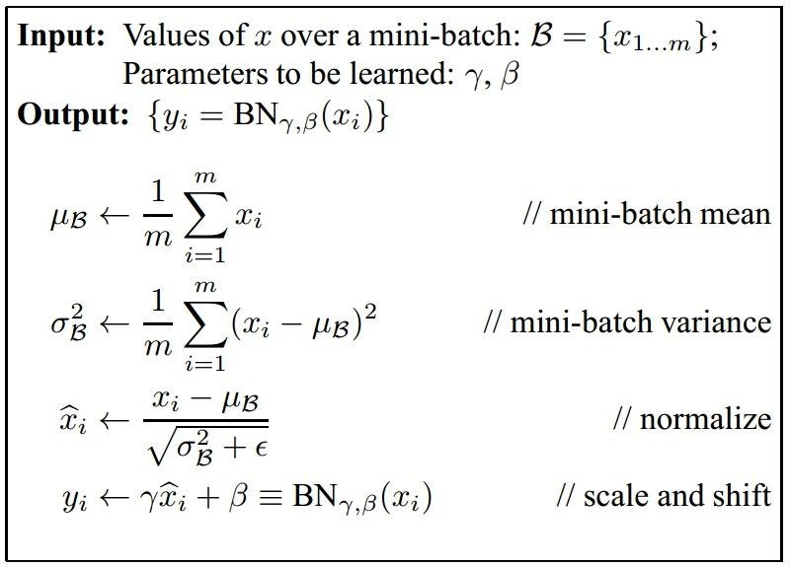
Batch Normalization
[Ioffe and Szegedy, 2015]
Improves gradient flow through the network
Allows higher learning rates
Reduces the strong dependence on initialization
Acts as a form of regularization
Fei-Fei Li & Justin Johnson & Serena Yeung Lecture 6 - April 19, 2018
Fei-Fei Li, Andrej Karpathy, Justin Johnson, Serena Yeung

Slide 30
Batch Normalization
[Ioffe and Szegedy, 2015]
Note: at test time BatchNorm layer functions differently:
The mean/std are not computed based on the batch. Instead, a single fixed empirical mean of activations during training is used.
(e.g. can be estimated during training with running averages)
Fei-Fei Li & Justin Johnson & Serena Yeung Lecture 6 - April 19, 2018
Fei-Fei Li, Andrej Karpathy, Justin Johnson, Serena Yeung

Slide 31
Babysitting the Learning Process
Preprocess data
Choose architecture
Initialize and check initial loss with no regularization
Increase regularization, loss should increase
Then train – try small portion of data, check you can overfit
Add regularization, and find learning rate that can make the loss go down
Check learning rates in range [1e-3 … 1e-5]
Coarse-to-fine search for hyperparameters (e.g. learning rate, regularization)
Fei-Fei Li, Andrej Karpathy, Justin Johnson, Serena Yeung

Slide 32
Random Search for
Grid and Random Search
Hyper-Parameter Optimization
Bergstra and Bengio, 2012
Grid Layout Random Layout
Unimportant Parameter
Unimportant Parameter
Important Parameter
Important Parameter
Illustration of Bergstra et al., 2012 by Shayne Longpre, copyright CS231n 2017
Lecture 7 -
32
Fei-Fei Li & Justin Johnson & Serena Yeung Lecture 7 - April 25, 2019
Fei-Fei Li, Justin Johnson, Serena Yeung

Slide 33
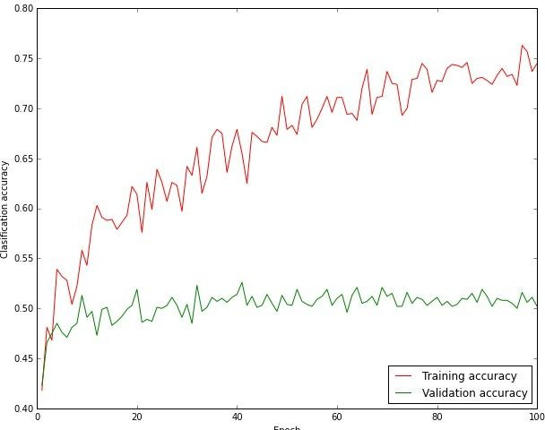
Monitor and Visualize Accuracy
big gap = overfitting
=> increase regularization strength?
no gap
=> increase model capacity?
Fei-Fei Li & Justin Johnson & Serena Yeung Lecture 6 - April 19, 2018
Fei-Fei Li, Andrej Karpathy, Justin Johnson, Serena Yeung

Slide 34
Dealing with sparse data
Deep neural networks require lots of data, and can overfit easily
The more weights you need to learn, the more data you need
That’s why with a deeper network, you need more data for training than for a shallower network
Ways to prevent overfitting include:
Using a validation set to stop training or pick parameters
Regularization
Data augmentation
Transfer learning

Slide 35
Over-training prevention
Running too many epochs can result in over-fitting.
Keep a hold-out validation set and test accuracy on it after every epoch. Stop training when additional epochs actually increase validation error.
error
on test data
on training data
0
# training epochs
Adapted from Ray Mooney

Slide 36
Determining best number of hidden units
Too few hidden units prevent the network from adequately fitting the data.
Too many hidden units can result in over-fitting.
Use internal cross-validation to empirically determine an optimal number of hidden units.
error
on test data
on training data
0
# hidden units
Ray Mooney

Slide 37

Effect of number of neurons
more neurons = more capacity
Andrej Karpathy

Slide 38
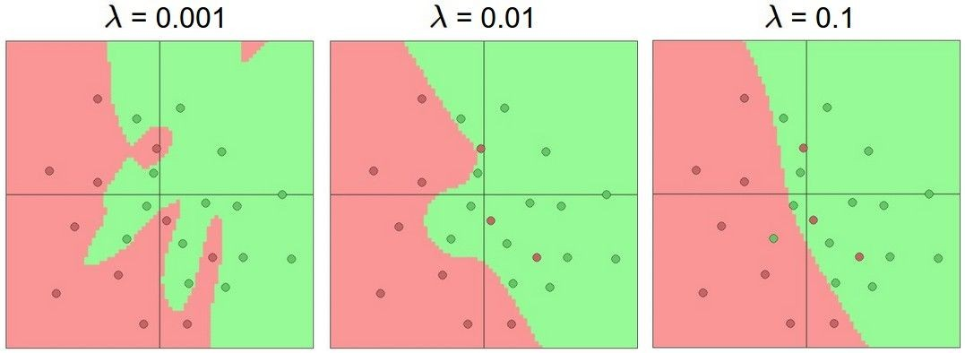
Do not use size of neural network as a regularizer. Use stronger regularization instead:
Effect of regularization
(you can play with this demo over at ConvNetJS: http://cs.stanford. edu/people/karpathy/convnetjs/demo/classify2d.html)
Andrej Karpathy

Slide 39
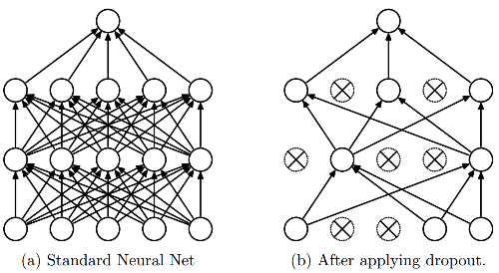
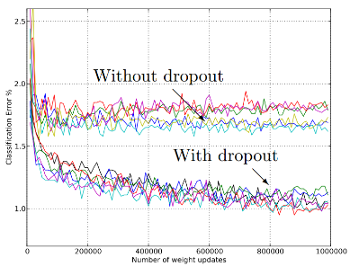
Regularization
L1, L2 regularization (weight decay)
Dropout
Randomly turn off some neurons
Allows individual neurons to independently be responsible for performance
Dropout: A simple way to prevent neural networks from overfitting [Srivastava JMLR 2014]
Adapted from Jia-bin Huang

Slide 40

Data Augmentation
“cat”
Load image and label
Compute loss
CNN
Fei-Fei Li & Justin Johnson & Serena Yeung Lecture 7 - April 24, 2018
Fei-Fei Li, Andrej Karpathy, Justin Johnson, Serena Yeung

Slide 41

Data Augmentation
“cat”
Load image and label
Compute loss
CNN
Transform image
Fei-Fei Li & Justin Johnson & Serena Yeung Lecture 7 - April 24, 2018
Fei-Fei Li, Andrej Karpathy, Justin Johnson, Serena Yeung

Slide 42

Data Augmentation
Horizontal Flips
Fei-Fei Li & Justin Johnson & Serena Yeung Lecture 7 - April 24, 2018
Fei-Fei Li, Andrej Karpathy, Justin Johnson, Serena Yeung

Slide 43
Data Augmentation
Random crops and scales
Training: sample random crops / scales
ResNet:
Pick random L in range [256, 480]
Resize training image, short side = L
Sample random 224 x 224 patch
Testing: average a fixed set of crops
ResNet:
1. Resize image at 5 scales: {224, 256, 384, 480, 640}
2. For each size, use 10 224 x 224 crops: 4 corners + center, + flips
Fei-Fei Li & Justin Johnson & Serena Yeung Lecture 7 - April 24, 2018
Fei-Fei Li, Andrej Karpathy, Justin Johnson, Serena Yeung

Slide 44
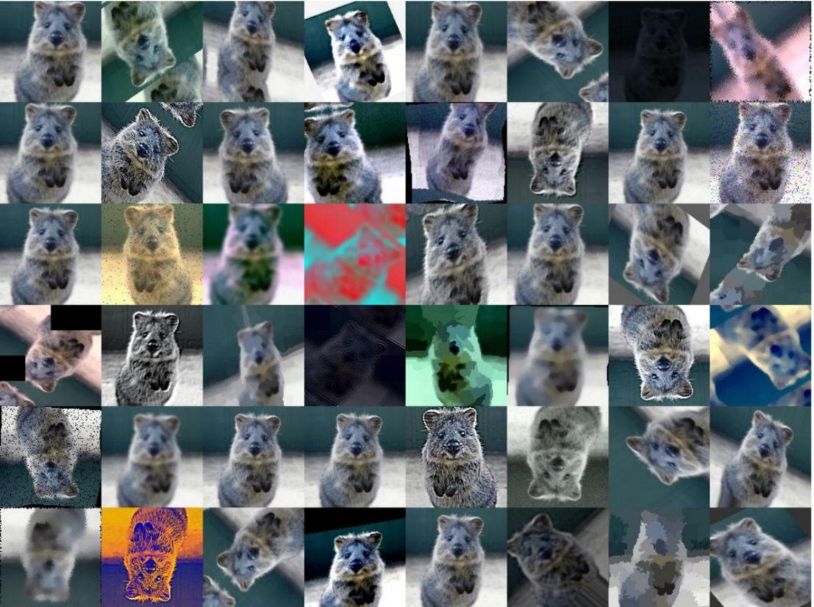
Data Augmentation
Get creative for your problem!
Random mix/combinations of :
translation
rotation
stretching
shearing,
lens distortions
…
Fei-Fei Li & Justin Johnson & Serena Yeung Lecture 7 - April 24, 2018
Fei-Fei Li, Andrej Karpathy, Justin Johnson, Serena Yeung; Image: https://github.com/aleju/imgaug

Slide 45

Data Augmentation
Slide from CS231n course, Stanford

Slide 46

Transfer learning
If you have sparse data in your domain of interest (target), but have rich data in a disjoint yet related domain (source),
You can train the early layers on the source domain, and only the last few layers on the target domain:
Set these to the already learned
weights from another network
Learn these on your own task

Slide 47
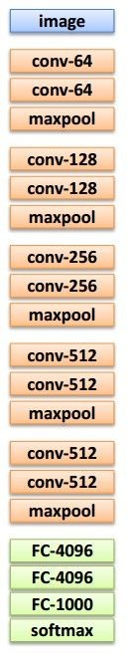
Transfer learning
Source: classify 20 animal classes Target: 10 car classes
1. Train on source (large dataset)
2. Small dataset:
3. Medium dataset:
finetuning
more data = retrain more of the network (or all of it)
Freeze these
Freeze these
Train this (or more);
use lower learning rate
Reinitialize and train this
Lecture 11 - 29
Another option: use network as feature extractor,
train SVM/LR on extracted features for target task
Adapted from Andrej Karpathy

Slide 48
Mini-batch gradient descent
In classic gradient descent, we compute the gradient from the loss for all training examples
Could also only use some of the data for each gradient update
We cycle through all the training examples multiple times
Each time we’ve cycled through all of them once is called an ‘epoch’
Allows faster training (e.g. on GPUs), parallelization

Slide 49
Training: Best practices
Center (subtract mean from) your data
Use Xavier initialization for weights
Use RELU or leaky RELU or ELU or PReLU
Use batch normalization
Use data augmentation
Use regularization
Use mini-batch
Learning rate: too high? Too low?
Use cross-validation for hyperparameters

Slide 50
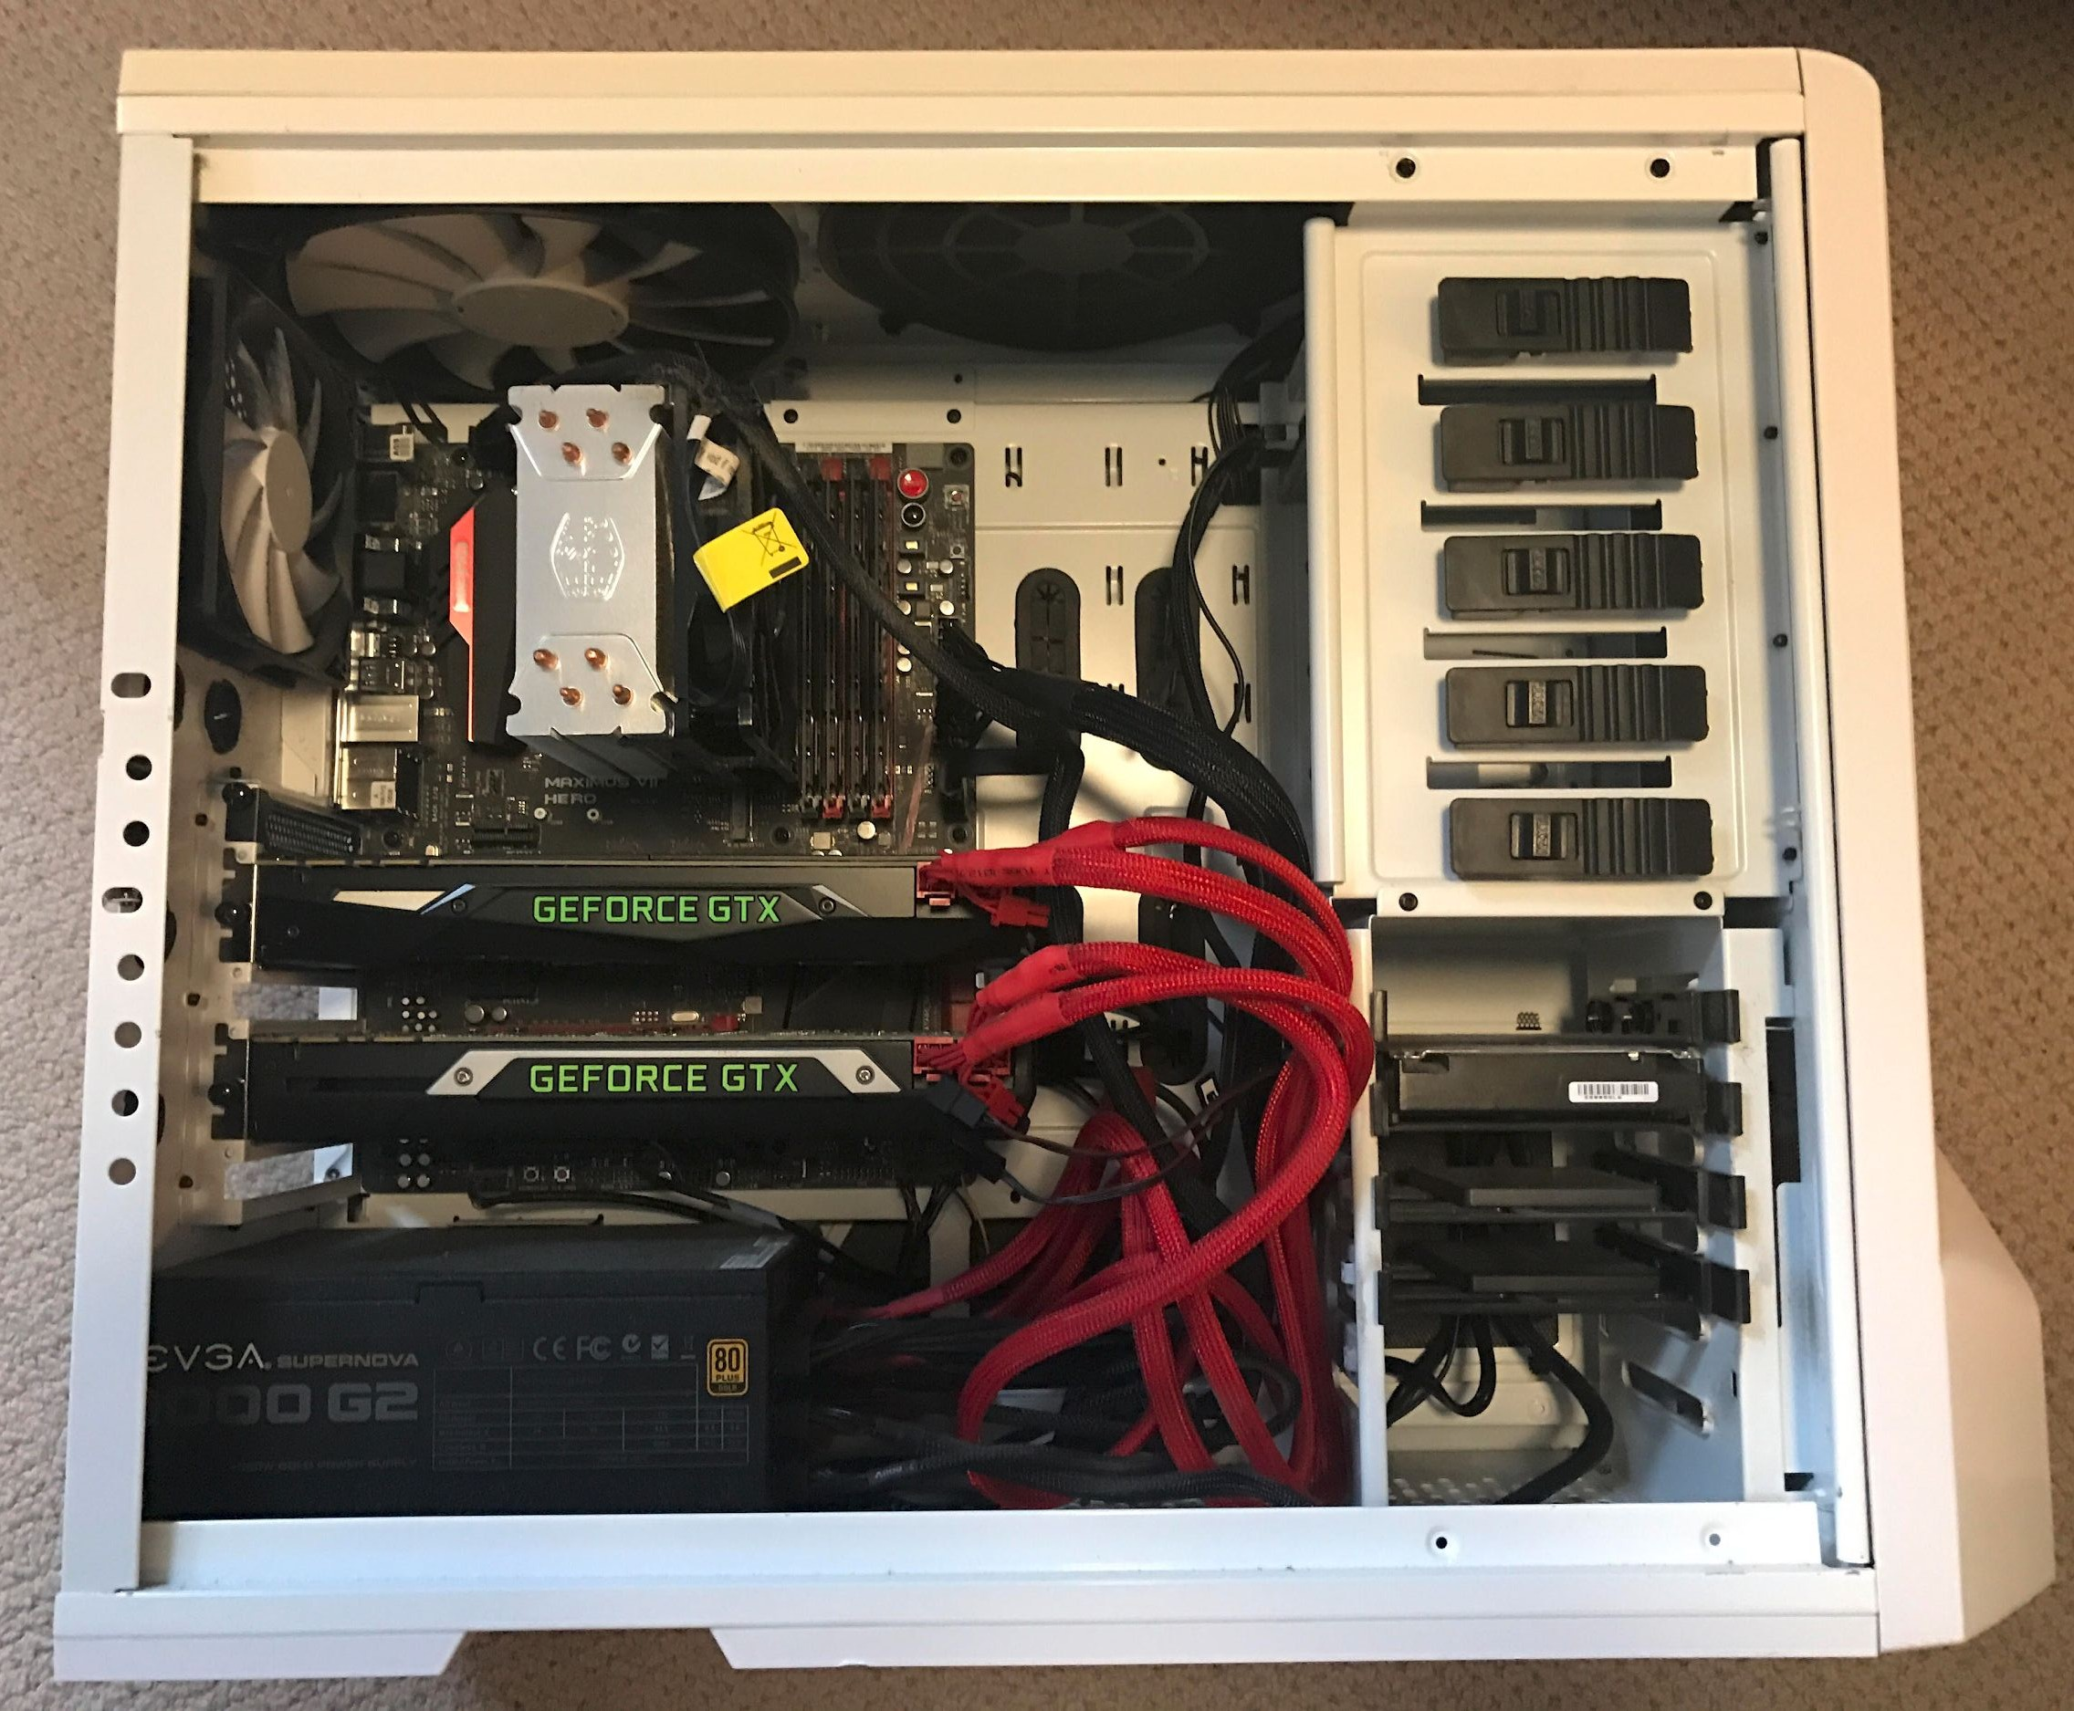
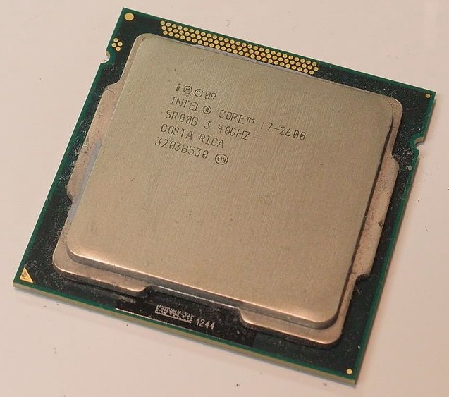
Spot the CPU! (central processing unit)
Fei-Fei Li & Justin Johnson & Serena Yeung
Fei-Fei Li, Andrej Karpathy, Justin Johnson, Serena Yeung

Slide 51

Spot the GPUs! (graphics processing unit)
Fei-Fei Li & Justin Johnson & Serena Yeung
Fei-Fei Li, Andrej Karpathy, Justin Johnson, Serena Yeung

Slide 52
CPU vs GPU
 | Cores | Clock Speed | Memory | Price* | Speed
CPU (Intel Core i7-7700k) | 4 | 4.2 GHz | System RAM | $385 | ~540 GFLOPs FP32
GPU (NVIDIA RTX 2080 Ti) | 4352 | 1.6 GHz | 11 GB GDDR6 | $1,199 | ~13.4 TFLOPs FP32
GPU (NVIDIA Quadro RTX 5000) | 3072 | 1.6 GHz | 16 GB GDDR6 | $2,299 | ~11.2 TFLOPs FP32
GPU (NVIDIA RTX A5000) | 8192 CUDA, 256 tensor | 1.2 GHz | 24 GB GDDR6 | $2,500 | ~27.8 TFLOPS FP32
TPU NVIDIA TITAN V | 5120 CUDA, 640 tensor | 1.5 GHz | 12GB HBM2 | $2,999 | ~14 TFLOPs FP32 ~112 TFLOP FP16
TPU Google Cloud TPU | ? | ? | 64 GB HBM | $4.50 / hr | ~180 TFLOP
CPU: Fewer cores, but each core is much faster and much more capable; great at sequential tasks
GPU: More cores, but each core is much slower and “dumber”; great for parallel tasks
TPU: Specialized hardware for deep learning
Fei-Fei Li & Justin Johnson & Serena Yeung
Adapted from Fei-Fei Li, Andrej Karpathy, Justin Johnson, Serena Yeung; https://en.wikipedia.org/wiki/List_of_Nvidia_graphics_processing_units

Slide 53
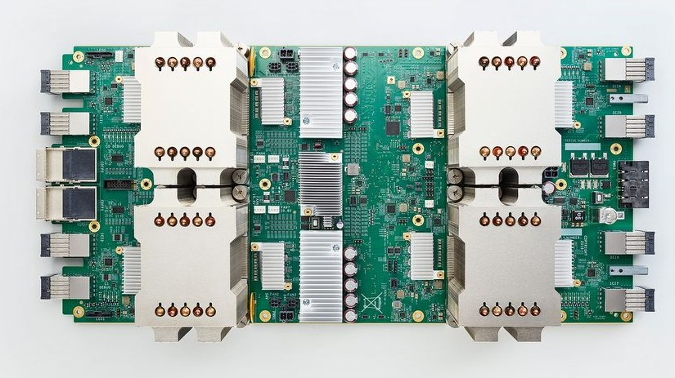

TensorFlow: Tensor Processing Units
Google Cloud TPU
= 180 TFLOPs of compute!
NVIDIA Tesla V100
= 125 TFLOPs of compute
NVIDIA Tesla P100 = 11 TFLOPs of compute GTX 580 = 0.2 TFLOPs
Lecture 6 -
53
Fei-Fei Li, Andrej Karpathy, Justin Johnson, Serena Yeung

Slide 54
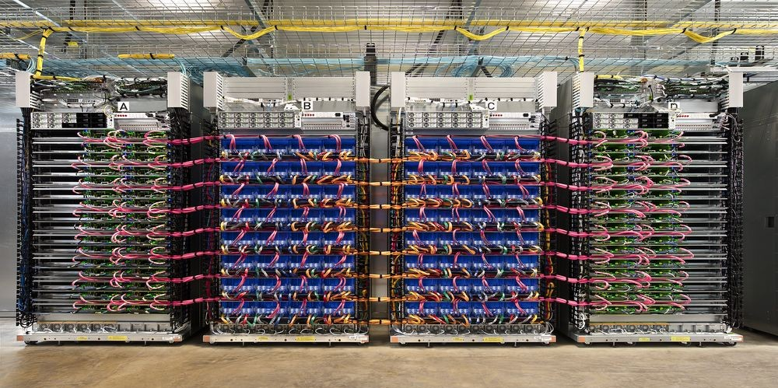
TensorFlow: Tensor Processing Units
Google Cloud TPU
= 180 TFLOPs of compute!
Google Cloud TPU Pod
= 64 Cloud TPUs
= 11.5 PFLOPs of compute!
https://www.tensorflow.org/versions/master/programmers_guide/using_tpu
Lecture 6 -
54
Fei-Fei Li, Andrej Karpathy, Justin Johnson, Serena Yeung

Slide 55
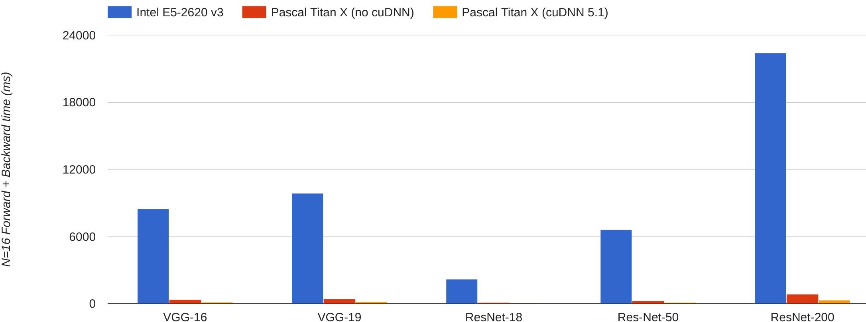



CPU vs GPU in practice
(CPU performance not
well-optimized, a little unfair)
66x
67x 71x 64x
76x
Data from https://github.com/jcjohnson/cnn-benchmarks
Fei-Fei Li & Justin Johnson & Serena Yeung
Fei-Fei Li & Justin Johnson & Serena Yeung Lecture 8 - April 26, 2018
Fei-Fei Li, Andrej Karpathy, Justin Johnson, Serena Yeung

Slide 56


CPU / GPU Communication
Model is here
Data is here
If you aren’t careful, training can bottleneck on reading data and transferring to GPU!
Solutions:
Read all data into RAM
Use SSD instead of HDD
Use multiple CPU threads to prefetch data
Fei-Fei Li & Justin Johnson & Serena Yeung
Fei-Fei Li & Justin Johnson & Serena Yeung Lecture 8 - April 26, 2018
Fei-Fei Li, Andrej Karpathy, Justin Johnson, Serena Yeung

Slide 57
Software: A zoo of frameworks!
PaddlePaddle
(Baidu)
Chainer
Caffe
(UC Berkeley)
Caffe2
(Facebook)
MXNet
(Amazon)
CNTK
(Microsoft)
Torch
(NYU / Facebook)
PyTorch
(Facebook)
JAX
(Google)
Theano
(U Montreal)
TensorFlow
(Google)
And others...
Fei-Fei Li & Justin Johnson & Serena Yeung
Fei-Fei Li & Justin Johnson & Serena Yeung Lecture 8 - April 26, 2018
Fei-Fei Li, Andrej Karpathy, Justin Johnson, Serena Yeung

Slide 58
Convergence of training

Slide 59
Successful training
We want training to converge (stop) at a reasonable place
Stopping is not guaranteed – e.g. imagine taking larger and larger steps…
Stopping in a good place is not guaranteed

Slide 60
Will backprop do the right thing?
In classification problems, classification error is a non-differentiable function of weights
The divergence function minimized (loss) is only a proxy for classification error
Minimizing loss may not minimize classification error
Adapted from Bhiksha Raj

Slide 61
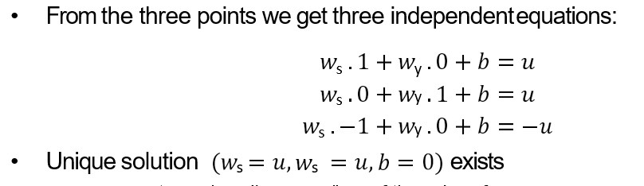



Will backprop do the right thing?
With these three points, backprop finds the right answer
(0,1), +1
(-1,0), -1
(1,0), +1
Adapted from Bhiksha Raj

Slide 62


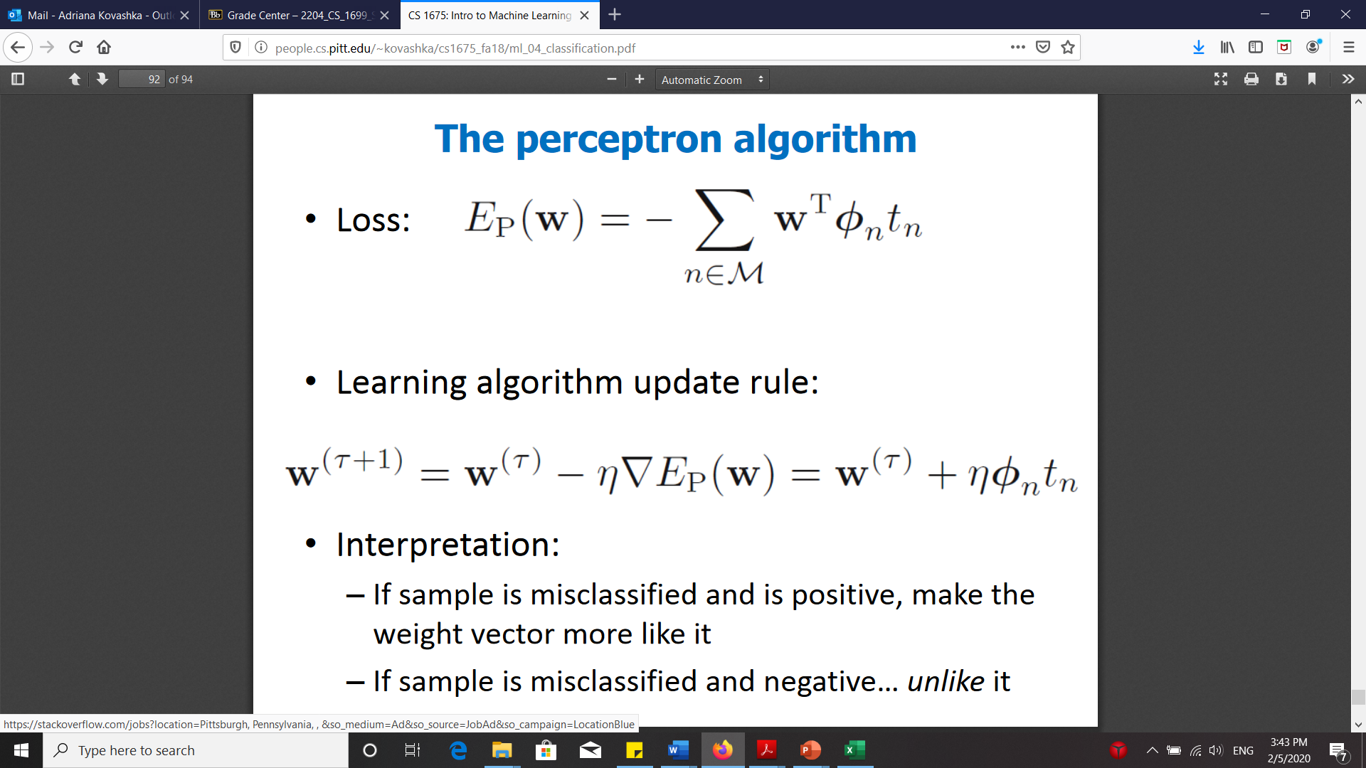
Will backprop do the right thing?
(0,1), +1
(-1,0), -1
(1,0), +1
(0,-t), +1
Now add a fourth point
With large enough t, 0 contribution of 4th point to derivative of L₂ error (e.g. if sigmoid/tanh used)
Local optimum solution found by backprop
Does not separate the points even though they are linearly separable!
Another algorithm (perceptron, in blue) does find the optimal separator
Adapted from Bhiksha Raj

Slide 63
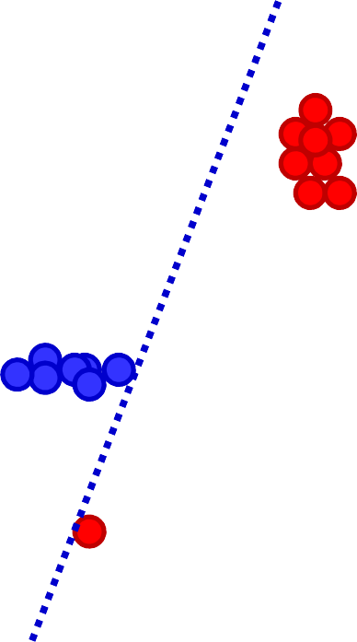
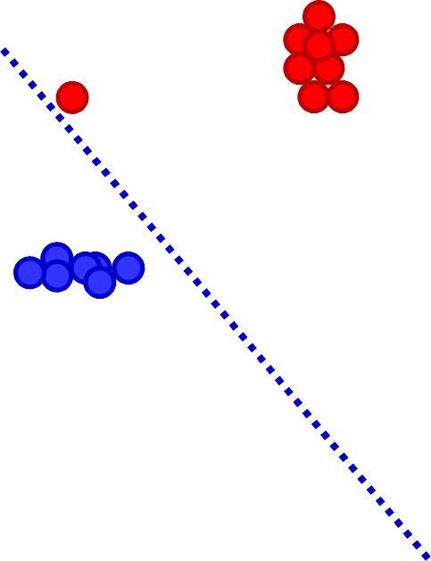

Will backprop do the right thing?
Adding a “spoiler” (or a small number of spoilers)
Perceptron finds the linear separator
For bounded w, backprop does not find a separator
A single additional input does not change the loss function significantly
Backprop is minimally changed by new training instances
Prefers consistency over perfection
Bhiksha Raj

Slide 64
Loss surfaces
Usually Loss(W) is not convex, so there are many local minima
However, in deep networks, these minima are reasonably similar – not true in small networks
What are desirable properties of the loss surface?

Slide 65
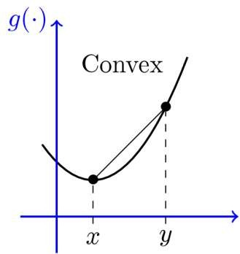
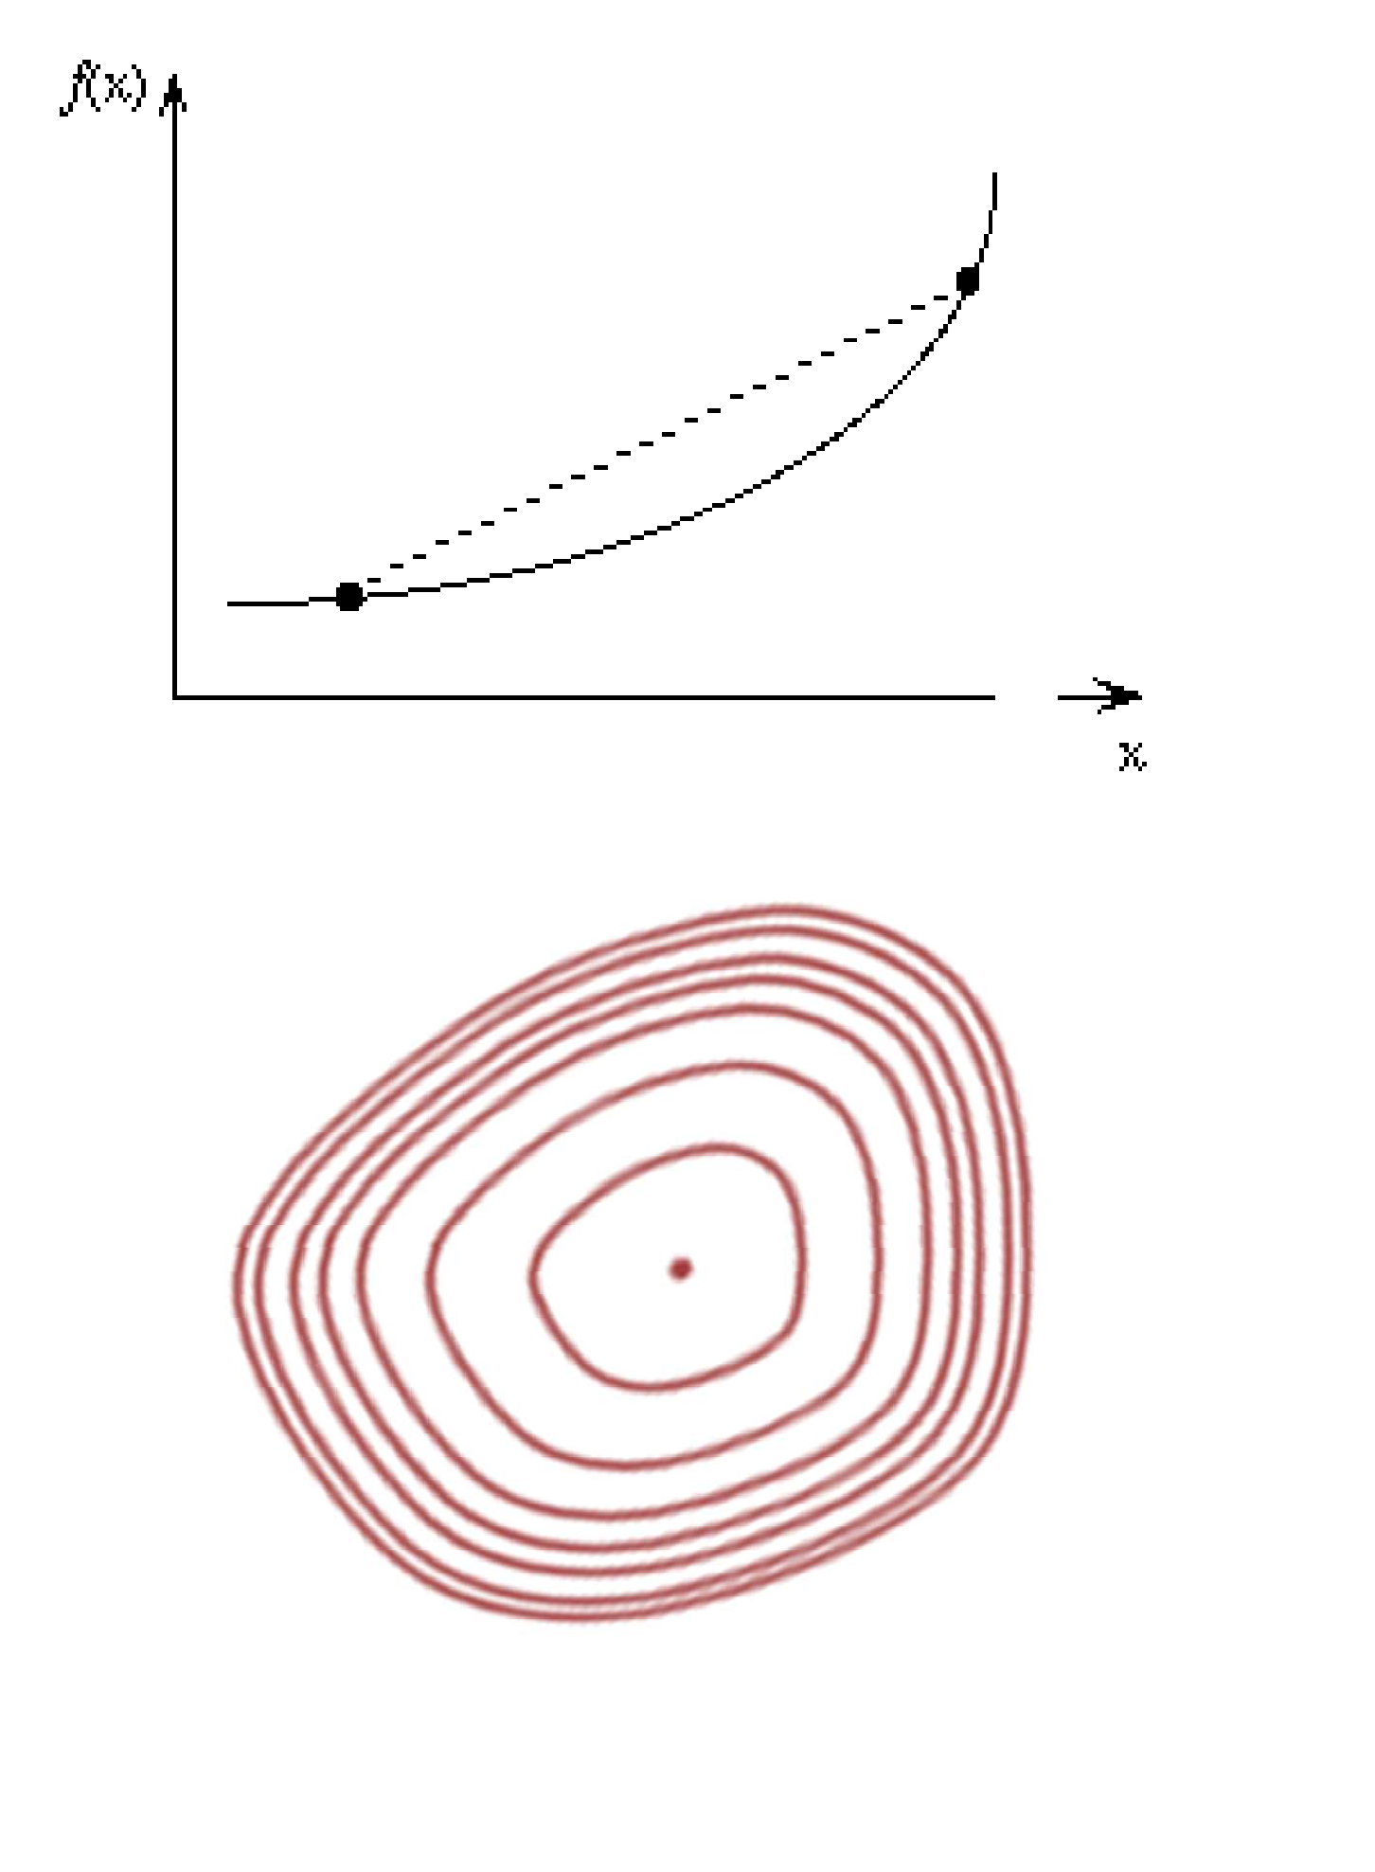
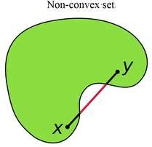

Convexity
A surface is “convex” if it continuously curves upward
We can connect any two points above the surface without intersecting it
Many mathematical definitions that are equivalent
Caveat: Neural net loss surface generally not convex
Non-convex set
Convex set
Adapted from Bhiksha Raj

Slide 66

The loss surface
Gradient descent makes the assumption that loss/objective has a single global optimum
What about local optima?
Adapted from Bhiksha Raj

Slide 67



The loss surface
Popular hypothesis:
Most local minima are equivalent
And close to global minimum
This is not true for small networks
In large networks, saddle points are far more common than local minima
Frequency exponential in network size
Saddle point: A point where:
The slope is zero
The surface increases in some directions, but decreases in others
Some of the Eigenvalues of the Hessian are positive; others are negative
Gradient descent algs often get “stuck” in saddle points
Bhiksha Raj

Slide 68
The controversial loss surface
Baldi and Hornik (89), “Neural Networks and Principal Component Analysis: Learning from Examples Without Local Minima” : An MLP with a single hidden layer has only saddle points and no local minima
Dauphin et. al (2015), “Identifying and attacking the saddle point problem in high-dimensional non-convex optimization” : An exponential number of saddle points in large networks
Chomoranksa et. al (2015), “The loss surface of multilayer networks” : For large networks, most local minima lie in a band and are equivalent
Swirscz et. al. (2016), “Local minima in training of deep networks”, In networks of finite size, trained on finite data, you can have horrible local minima
Watch this space…
Adapted from Bhiksha Raj

Slide 69
Conditions for convergence
So far we have assumed training arrives at a local minimum
Does it always converge?
How long does it take?
Hard to analyze for a neural network, but we can look at the problem through the lens of convex optimization
Adapted from Bhiksha Raj

Slide 70

Convergence and convergence rate
An iterative algorithm is said to converge to a solution if the value updates arrive at a fixed point
Where the gradient is 0 and further updates do not change the estimate
The algorithm may not converge
It may jitter around the local minimum
It may even diverge
Conditions for convergence?
Bhiksha Raj

Slide 71

Convergence and convergence rate
Convergence rate: how fast iterations arrive at the solution
Generally quantified as:
If R is a constant (or upper-bounded): convergence is linear
Adapted from Bhiksha Raj

Slide 72

With non-optimal step size
Bhiksha Raj

Slide 73


Multivariate quadratic surface
Optimal learning rate is different for the different coordinates
The learning rate must be lower than twice the smallest optimal learning rate for any component
Otherwise the learning will diverge
This, however, makes the learning very slow
Convergence is particularly slow if the following is large (the “condition” number is small)
Adapted from Bhiksha Raj

Slide 74

Dependence on learning rate
Bhiksha Raj

Slide 75
Optimization strategies

Slide 76
Getting to the minimum
Gradient descent is just one strategy, but has several problems
What other “steps” can we take?
How far in the direction of decreasing gradient do we go? With what speed/acceleration?
What about overshooting minima?

Slide 77



Optimization
W_2
W_1
Fei-Fei Li & Justin Johnson & Serena Yeung Lecture 7 - April 24, 2018
Fei-Fei Li, Andrej Karpathy, Justin Johnson, Serena Yeung

Slide 78

Optimization: Problems with SGD
What if loss changes quickly in one direction and slowly in another? What does gradient descent do?
Loss function has high condition number: ratio of largest to smallest
singular value of the Hessian matrix is large
Fei-Fei Li & Justin Johnson & Serena Yeung Lecture 7 - April 24, 2018
Fei-Fei Li, Andrej Karpathy, Justin Johnson, Serena Yeung

Slide 79

Optimization: Problems with SGD
What if loss changes quickly in one direction and slowly in another? What does gradient descent do?
Very slow progress along shallow dimension, jitter along steep direction
Loss function has high condition number: ratio of largest to smallest
singular value of the Hessian matrix is large
Fei-Fei Li & Justin Johnson & Serena Yeung Lecture 7 - April 24, 2018
Fei-Fei Li, Andrej Karpathy, Justin Johnson, Serena Yeung

Slide 80


Optimization: Problems with SGD
What if the loss function has a local minima or saddle point?
Zero gradient, gradient descent gets stuck
Fei-Fei Li & Justin Johnson & Serena Yeung Lecture 7 - April 24, 2018
Fei-Fei Li, Andrej Karpathy, Justin Johnson, Serena Yeung

Slide 81




Optimization: Problems with SGD
Our gradients come from minibatches so they can be noisy!
Fei-Fei Li & Justin Johnson & Serena Yeung Lecture 7 - April 24, 2018
Fei-Fei Li, Andrej Karpathy, Justin Johnson, Serena Yeung

Slide 82




SGD + Momentum
SGD
SGD+Momentum
Build up “velocity” as a running mean of gradients
Rho gives “friction”; typically rho=0.9 or 0.99
Sutskever et al, “On the importance of initialization and momentum in deep learning”, ICML 2013
Fei-Fei Li & Justin Johnson & Serena Yeung Lecture 7 - April 24, 2018
Fei-Fei Li, Andrej Karpathy, Justin Johnson, Serena Yeung

Slide 83

AdaGrad
Added element-wise scaling of the gradient based on the historical sum of squares in each dimension
“Per-parameter learning rates” or “adaptive learning rates”
Duchi et al, “Adaptive subgradient methods for online learning and stochastic optimization”, JMLR 2011
Fei-Fei Li & Justin Johnson & Serena Yeung Lecture 7 - April 24, 2018
Fei-Fei Li, Andrej Karpathy, Justin Johnson, Serena Yeung

Slide 84

AdaGrad
Q: What happens with AdaGrad?
Progress along “steep” directions is damped; progress along “flat” directions is accelerated
Fei-Fei Li & Justin Johnson & Serena Yeung Lecture 7 - April 24, 2018
Fei-Fei Li, Andrej Karpathy, Justin Johnson, Serena Yeung

Slide 85
AdaGrad
Q2: What happens to the step size over long time?
Fei-Fei Li & Justin Johnson & Serena Yeung Lecture 7 - April 24, 2018
Fei-Fei Li, Andrej Karpathy, Justin Johnson, Serena Yeung

Slide 86


RMSProp
AdaGrad
RMSProp
Tieleman and Hinton, 2012
Fei-Fei Li & Justin Johnson & Serena Yeung Lecture 7 - April 24, 2018
Fei-Fei Li, Andrej Karpathy, Justin Johnson, Serena Yeung

Slide 87

Adam
Momentum
Bias correction
AdaGrad / RMSProp
Bias correction for the fact that first and second moment estimates start at zero
Adam with beta1 = 0.9,
beta2 = 0.999, and learning_rate = 1e-3 or 5e-4 is a great starting point for many models!
Kingma and Ba, “Adam: A method for stochastic optimization”, ICLR 2015
Fei-Fei Li & Justin Johnson & Serena Yeung Lecture 7 - April 24, 2018
Fei-Fei Li, Andrej Karpathy, Justin Johnson, Serena Yeung

Slide 88

Optimizers comparison
https://imgur.com/a/Hqolp
Fei-Fei Li, Andrej Karpathy, Justin Johnson, Serena Yeung

Slide 89
Visualization
https://www.deeplearning.ai/ai-notes/optimization/
(bottom of page)
“In this visualization, you can compare optimizers applied to different cost functions and initialization. For a given cost landscape (1) and initialization (2), you can choose optimizers, their learning rate and decay (3). Then, press the play button to see the optimization process (4). There's no explicit model, but you can assume that finding the cost function's minimum is equivalent to finding the best model for your task.”

Slide 90



SGD, SGD+Momentum, Adagrad, RMSProp, Adam all have
learning rate as a hyperparameter.
=> Learning rate decay over time!
step decay:
e.g. decay learning rate by half every few epochs.
exponential decay:
1/t decay:
Fei-Fei Li & Justin Johnson & Serena Yeung Lecture 7 - April 24, 2018
Fei-Fei Li, Andrej Karpathy, Justin Johnson, Serena Yeung

Slide 91
SGD, SGD+Momentum, Adagrad, RMSProp, Adam all have
learning rate as a hyperparameter.
Q: Which one of these learning rates is best to use?
A: All of them! Start with large learning rate and decay over time
Lecture 7 -
Fei-Fei Li & Justin Johnson & Serena Yeung Lecture 7 - April 24, 2018
Fei-Fei Li, Justin Johnson, Serena Yeung

Slide 92
SGD, SGD+Momentum, Adagrad, RMSProp, Adam all have
learning rate as a hyperparameter.
Loss
Learning rate decay!
Epoch
Fei-Fei Li & Justin Johnson & Serena Yeung Lecture 7 - April 24, 2018
Also see https://openreview.net/pdf?id=r1eOnh4YPB
Adapted from Fei-Fei Li, Andrej Karpathy, Justin Johnson, Serena Yeung

Slide 93
Loss
Bad initialization a prime suspect
time
Lecture 7 -
Fei-Fei Li & Justin Johnson & Serena Yeung Lecture 7 - April 24, 2018
Fei-Fei Li, Justin Johnson, Serena Yeung

Slide 94
Loss
Loss plateaus: Try learning rate decay
time
Lecture 7 -
94
Fei-Fei Li & Justin Johnson & Serena Yeung Lecture 7 - April 25, 2019
Fei-Fei Li, Justin Johnson, Serena Yeung

Slide 95
Loss
Learning rate step decay
Loss was still going down when learning rate dropped, you decayed too early!
time
Lecture 7 -
95
Fei-Fei Li & Justin Johnson & Serena Yeung Lecture 7 - April 25, 2019
Fei-Fei Li, Justin Johnson, Serena Yeung

Slide 96
First-Order Optimization
Loss
w1
Lecture 7 -
Fei-Fei Li & Justin Johnson & Serena Yeung Lecture 7 - April 24, 2018
Fei-Fei Li, Justin Johnson, Serena Yeung

Slide 97

First-Order Optimization
Use gradient form linear approximation
Step to minimize the approximation
Loss
w1
Lecture 7 -
Fei-Fei Li & Justin Johnson & Serena Yeung Lecture 7 - April 24, 2018
Fei-Fei Li, Justin Johnson, Serena Yeung

Slide 98

Second-Order Optimization
Use gradient and Hessian to form quadratic approximation
Step to the minima of the approximation
Loss
w1
Lecture 7 -
Fei-Fei Li & Justin Johnson & Serena Yeung Lecture 7 - April 24, 2018
Fei-Fei Li, Justin Johnson, Serena Yeung

Slide 99


Second-Order Optimization
second-order Taylor expansion:
Solving for the critical point we obtain the Newton parameter update:
Hessian has O(N^2) elements Inverting takes O(N^3)
N = (Tens or Hundreds of) Millions
Q: Why is this bad for deep learning?
Partial solution: Quasi-Newton methods (e.g. BGFS) approximate inverse Hessian
Lecture 7 -
Fei-Fei Li & Justin Johnson & Serena Yeung Lecture 7 - April 24, 2018
Adapted from Fei-Fei Li, Justin Johnson, Serena Yeung
http://www.cs.cornell.edu/courses/cs4780/2015fa/web/lecturenotes/lecturenote07.html

Slide 100
Choosing Hyperparameters
Step 1: Check initial loss
Without weight decay (regularization), sanity check loss at initialization
e.g. log(C) for softmax with C classes
Lecture 7 -
Fei-Fei Li & Justin Johnson & Serena Yeung Lecture 7 - April 24, 2018
Adapted from Fei-Fei Li, Justin Johnson, Serena Yeung

Slide 101
Choosing Hyperparameters
Step 1: Check initial loss
Step 2: Overfit a small sample
Try to train to 100% training accuracy on a small sample of training data (~5-10 minibatches); fiddle with architecture, learning rate, weight initialization
Loss not going down? LR too low, bad initialization
Loss explodes to Inf or NaN? LR too high, bad initialization
Lecture 7 -
Fei-Fei Li & Justin Johnson & Serena Yeung Lecture 7 - April 24, 2018
Fei-Fei Li, Justin Johnson, Serena Yeung

Slide 102
Choosing Hyperparameters
Step 1: Check initial loss
Step 2: Overfit a small sample
Step 3: Find LR that makes loss go down
Use the architecture from the previous step, use all training data, turn on small weight decay, find a learning rate that makes the loss drop significantly within ~100 iterations
Good learning rates to try: 1e-1, 1e-2, 1e-3, 1e-4
Good weight decay to try: 1e-4, 1e-5, 0
Lecture 7 -
Fei-Fei Li & Justin Johnson & Serena Yeung Lecture 7 - April 24, 2018
Adapted from Fei-Fei Li, Justin Johnson, Serena Yeung

Slide 103
Choosing Hyperparameters
Step 1: Check initial loss
Step 2: Overfit a small sample
Step 3: Find LR that makes loss go down
Step 4: Coarse grid search, train for ~1-5 epochs
Choose a few values of learning rate and weight decay around what worked from Step 3, train a few models for ~1-5 epochs.
Lecture 7 -
Fei-Fei Li & Justin Johnson & Serena Yeung Lecture 7 - April 24, 2018
Adapted from Fei-Fei Li, Justin Johnson, Serena Yeung

Slide 104
Choosing Hyperparameters
Step 1: Check initial loss
Step 2: Overfit a small sample
Step 3: Find LR that makes loss go down Step 4: Coarse grid, train for ~1-5 epochs
Step 5: Refine grid, train longer
Pick best models from Step 4, train them for longer (~10-20 epochs) without learning rate decay
Lecture 7 -
Fei-Fei Li & Justin Johnson & Serena Yeung Lecture 7 - April 24, 2018
Fei-Fei Li, Justin Johnson, Serena Yeung

Slide 105
Choosing Hyperparameters
Step 1: Check initial loss
Step 2: Overfit a small sample
Step 3: Find LR that makes loss go down Step 4: Coarse grid, train for ~1-5 epochs Step 5: Refine grid, train longer
Step 6: Look at loss curves
Lecture 7 -
Fei-Fei Li & Justin Johnson & Serena Yeung Lecture 7 - April 24, 2018
Fei-Fei Li, Justin Johnson, Serena Yeung

Slide 106


Look at learning curves!
Training Loss
Train / Val Accuracy
Losses may be noisy, use a scatter plot and also plot moving average to see trends better
Lecture 7 -
Fei-Fei Li & Justin Johnson & Serena Yeung Lecture 7 - April 24, 2018
Fei-Fei Li, Justin Johnson, Serena Yeung

Slide 107
Accuracy still going up, you need to train longer
Accuracy
Train
Val
time
Lecture 7 -
107
Fei-Fei Li & Justin Johnson & Serena Yeung Lecture 7 - April 25, 2019
Fei-Fei Li, Justin Johnson, Serena Yeung

Slide 108
Huge train / val gap means overfitting! Increase regularization, get more data
Accuracy
Train
Val
time
Lecture 7 -
108
Fei-Fei Li & Justin Johnson & Serena Yeung Lecture 7 - April 25, 2019
Fei-Fei Li, Justin Johnson, Serena Yeung

Slide 109
No gap between train / val means underfitting: train longer, use a bigger model
Accuracy
Train
Val
time
Lecture 7 -
109
Fei-Fei Li & Justin Johnson & Serena Yeung Lecture 7 - April 25, 2019
Fei-Fei Li, Justin Johnson, Serena Yeung

Slide 110

Track the ratio of weight updates / weight magnitudes:
ratio between the updates and values: ~ 0.0002 / 0.02 = 0.01 (about okay)
want this to be somewhere around 0.001 or so
Lecture 7 -
110
Fei-Fei Li & Justin Johnson & Serena Yeung Lecture 7 - April 25, 2019
Fei-Fei Li, Justin Johnson, Serena Yeung

Slide 111
Model Ensembles
Train multiple independent models
At test time average their results
(Take average of predicted probability distributions, then choose argmax)
Enjoy 2% extra performance
Lecture 7 -
Fei-Fei Li & Justin Johnson & Serena Yeung Lecture 7 - April 24, 2018
Fei-Fei Li, Justin Johnson, Serena Yeung

Slide 112

Model Ensembles: Tips and Tricks
Instead of training independent models, use multiple snapshots of a single model during training!
Loshchilov and Hutter, “SGDR: Stochastic gradient descent with restarts”, arXiv 2016 Huang et al, “Snapshot ensembles: train 1, get M for free”, ICLR 2017
Figures copyright Yixuan Li and Geoff Pleiss, 2017. Reproduced with permission.
Lecture 7 -
Fei-Fei Li & Justin Johnson & Serena Yeung Lecture 7 - April 24, 2018
Fei-Fei Li, Justin Johnson, Serena Yeung

Slide 113


Model Ensembles: Tips and Tricks
Instead of training independent models, use multiple snapshots of a single model during training!
Loshchilov and Hutter, “SGDR: Stochastic gradient descent with restarts”, arXiv 2016 Huang et al, “Snapshot ensembles: train 1, get M for free”, ICLR 2017
Figures copyright Yixuan Li and Geoff Pleiss, 2017. Reproduced with permission.
Cyclic learning rate schedules can make this work even better!
Lecture 7 -
58
Fei-Fei Li & Justin Johnson & Serena Yeung Lecture 7 - April 24, 2018
Fei-Fei Li, Justin Johnson, Serena Yeung

Slide 114
Summary
Improve your training error:
Optimizers
Learning rate schedules
Improve your test error:
Regularization
Choosing hyperparameters
Model ensembles
Lecture 7 -
114
Fei-Fei Li & Justin Johnson & Serena Yeung Lecture 7 - April 25, 2019
Adapted from Fei-Fei Li, Justin Johnson, Serena Yeung

Slide 115
Computation graphs

Slide 116
How do we compute the gradient?
Derive on paper? Tedious
What about vector-valued functions?

Slide 117



Computational graphs
x
*
s (scores)
hinge loss
+
L
W
R
Fei-Fei Li, Justin Johnson, Serena Yeung

Slide 118









Backpropagation: a simple example
e.g. x = -2, y = 5, z = -4
Chain rule:
Want:
Upstream gradient
Local gradient
April 13, 2017
Fei-Fei Li, Justin Johnson, Serena Yeung

Slide 119







f
“local gradient”
Adapted from Fei-Fei Li, Justin Johnson, Serena Yeung

Slide 120


Another example:
Fei-Fei Li, Justin Johnson, Serena Yeung

Slide 121
Another example:
Fei-Fei Li, Justin Johnson, Serena Yeung

Slide 122


Another example:
Fei-Fei Li, Justin Johnson, Serena Yeung

Slide 123

Another example:
Upstream gradient
Local gradient
Fei-Fei Li, Justin Johnson, Serena Yeung

Slide 124
Another example:
Upstream gradient
Local gradient
Fei-Fei Li, Justin Johnson, Serena Yeung

Slide 125
Another example:
Upstream gradient
Local gradient
Fei-Fei Li, Justin Johnson, Serena Yeung

Slide 126
Another example:
Upstream gradient
Local gradient
Fei-Fei Li, Justin Johnson, Serena Yeung

Slide 127
Another example:
[upstream gradient] x [local gradient] [0.2] x [1] = 0.2
[0.2] x [1] = 0.2 (both inputs!)
Fei-Fei Li, Justin Johnson, Serena Yeung

Slide 128
Another example:
Fei-Fei Li, Justin Johnson, Serena Yeung

Slide 129

Another example:
[upstream gradient] x [local gradient] x0: [0.2] x [2] = 0.4
w0: [0.2] x [-1] = -0.2
Fei-Fei Li, Justin Johnson, Serena Yeung

Slide 130

Another example:
Computational graph representation may not be unique. Choose one where local gradients at each node can be easily expressed!
Sigmoid function
Sigmoid
Fei-Fei Li, Justin Johnson, Serena Yeung

Slide 131
Another example:
Computational graph representation may not be unique. Choose one where local gradients at each node can be easily expressed!
Sigmoid function
Sigmoid
[upstream gradient] x [local gradient] [1.00] x [(1 - 0.73) (0.73)] = 0.2
Sigmoid local gradient:
Fei-Fei Li, Justin Johnson, Serena Yeung

Slide 132
Patterns in gradient flow
add gate: gradient distributor 3
mul gate: “swap multiplier” 2
2
4
₊ 7
5*3=15
3
× 6
2
5
2
copy gate: gradient adder
7
7
4+2=6
5*2=10
max gate: gradient router 4
4
7
0
5
5
9
max
2
9
Fei-Fei Li, Justin Johnson, Serena Yeung

Slide 133



Backprop Implementation: “Flat” code
Forward pass: Compute output
Backward pass: Compute grads
Fei-Fei Li, Justin Johnson, Serena Yeung

Slide 134
Backprop Implementation: “Flat” code
Forward pass: Compute output
Base case
Fei-Fei Li, Justin Johnson, Serena Yeung

Slide 135
Backprop Implementation: “Flat” code
Forward pass: Compute output
Sigmoid
Fei-Fei Li, Justin Johnson, Serena Yeung

Slide 136
Backprop Implementation: “Flat” code
Forward pass: Compute output
Add gate
Fei-Fei Li, Justin Johnson, Serena Yeung

Slide 137
Backprop Implementation: “Flat” code
Forward pass: Compute output
Add gate
Fei-Fei Li, Justin Johnson, Serena Yeung

Slide 138
Backprop Implementation: “Flat” code
Forward pass: Compute output
Multiply gate
Fei-Fei Li, Justin Johnson, Serena Yeung

Slide 139
Backprop Implementation: “Flat” code
Forward pass: Compute output
Multiply gate
Fei-Fei Li, Justin Johnson, Serena Yeung

Slide 140
So far: backprop with scalars
What about vector-valued functions?
Fei-Fei Li, Justin Johnson, Serena Yeung

Slide 141


Recap: Vector derivatives
Scalar to Scalar
Regular derivative:
If x changes by a small amount, how much will y change?
Lecture 4 - 141
Fei-Fei Li, Justin Johnson, Serena Yeung

Slide 142



Recap: Vector derivatives
Scalar to Scalar Vector to Scalar
Regular derivative:
Derivative is Gradient:
If x changes by a small amount, how much will y change?
For each element of x, if it changes by a small amount then how much will y change?
Lecture 4 - 142
Fei-Fei Li, Justin Johnson, Serena Yeung

Slide 143



Recap: Vector derivatives
Scalar to Scalar Vector to Scalar
Vector to Vector
Regular derivative:
Derivative is Gradient:
Derivative is Jacobian:
If x changes by a small amount, how much will y change?
For each element of x, if it changes by a small amount then how much will y change?
For each element of x, if it changes by a small amount then how much will each element of y change?
Lecture 4 - 143
Fei-Fei Li, Justin Johnson, Serena Yeung

Slide 144


Gradients
Given a function with 1 output and n inputs
Its gradient is a vector of partial derivatives with respect to each input
Christopher Manning

Slide 145


Jacobian Matrix: Generalization of Gradient
Given a function with m outputs and n inputs
Its Jacobian is an m x n matrix of partial derivatives
Christopher Manning

Slide 146


Chain Rule
For one-variable functions: multiply derivatives
For multiple variables at once: multiply Jacobians
Christopher Manning

Slide 147


Example Jacobian: Elementwise activation Function
Christopher Manning

Slide 148
Example Jacobian: Elementwise activation Function
Function has n outputs and n inputs → n by n Jacobian
Christopher Manning

Slide 149

Example Jacobian: Elementwise activation Function
Christopher Manning

Slide 150
Example Jacobian: Elementwise activation Function
Christopher Manning

Slide 151



Example Jacobian: Elementwise activation Function
Christopher Manning

Slide 152



Backprop with Vectors
D_{x}
Loss L still a scalar!
“local gradients”
[D_{x} x D_{z}]
f
D_{x}
D_{z}
“Downstream
gradients”
Matrix-vector multiply
[D x D ]
D_{z}
D_{y}
y z
Jacobian matrices
“Upstream gradient” For each element of z, how much does it influence L?
D_{y}
Lecture 4 - 152
Fei-Fei Li, Justin Johnson, Serena Yeung

Slide 153
Backprop with Vectors
4D input x:
4D output y:
[ 1 ]
[ -2 ]
[ 3 ]
[ -1 ]
f(x) = max(0,x)
(elementwise)
[ 1 ]
[ 0 ]
[ 3 ]
[ 0 ]
Lecture 4 - 153
Fei-Fei Li, Justin Johnson, Serena Yeung

Slide 154
Backprop with Vectors
4D input x:
4D output y:
[ 1 ]
[ -2 ]
[ 3 ]
[ -1 ]
f(x) = max(0,x)
(elementwise)
[ 1 ]
[ 0 ]
[ 3 ]
[ 0 ]
4D dL/dy:
Upstream gradient
[ | 4 ]
[ | -1 ]
[ | 5 ]
[ | 9 ]
Lecture 4 - 154
Fei-Fei Li, Justin Johnson, Serena Yeung

Slide 155
Backprop with Vectors
4D input x:
4D output y:
[ 1 ]
[ -2 ]
[ 3 ]
[ -1 ]
f(x) = max(0,x)
(elementwise)
[ 1 ]
[ 0 ]
[ 3 ]
[ 0 ]
Jacobian dy/dx [ 1 0 0 0 ]
[ 0 0 0 0 ]
[ 0 0 1 0 ]
[ 0 0 0 0 ]
4D dL/dy:
[ 4 ]
[ -1 ]
[ 5 ]
[ 9 ]
Upstream gradient
Lecture 4 - 155
Fei-Fei Li, Justin Johnson, Serena Yeung

Slide 156
Backprop with Vectors
4D input x:
4D output y:
[ 1 ]
[ -2 ]
[ 3 ]
[ -1 ]
f(x) = max(0,x)
(elementwise)
[ 1 ]
[ 0 ]
[ 3 ]
[ 0 ]
[dy/dx] [dL/dy] [ 1 0 0 0 ] [ 4 ]
[ 0 0 0 0 ] [ -1 ]
[ 0 0 1 0 ] [ 5 ]
[ 0 0 0 0 ] [ 9 ]
4D dL/dy:
[ 4 ]
[ -1 ]
[ 5 ]
[ 9 ]
Upstream gradient
Lecture 4 - 156
Fei-Fei Li, Justin Johnson, Serena Yeung

Slide 157
Backprop with Vectors
4D input x:
4D output y:
[ 1 ]
[ -2 ]
[ 3 ]
[ -1 ]
f(x) = max(0,x)
(elementwise)
[ 1 ]
[ 0 ]
[ 3 ]
[ 0 ]
4D dL/dx: [ 4 ]
[ 0 ]
[ 5 ]
[ 0 ]
[dy/dx] [dL/dy] [ 1 0 0 0 ] [ 4 ]
[ 0 0 0 0 ] [ -1 ]
[ 0 0 1 0 ] [ 5 ]
[ 0 0 0 0 ] [ 9 ]
4D dL/dy:
[ 4 ]
[ -1 ]
[ 5 ]
[ 9 ]
Upstream gradient
Lecture 4 - 157
Fei-Fei Li, Justin Johnson, Serena Yeung

Slide 158
Backprop with Vectors
4D input x:
4D output y:
[ 1 ]
[ -2 ]
[ 3 ]
[ -1 ]
f(x) = max(0,x)
(elementwise)
[ 1 ]
[ 0 ]
[ 3 ]
[ 0 ]
Jacobian is sparse: off-diagonal entries always zero! Never explicitly form Jacobian -- instead use implicit multiplication
4D dL/dx: [ 4 ]
[ 0 ]
[ 5 ]
[ 0 ]
[dy/dx] [dL/dy] [ 1 0 0 0 ] [ 4 ]
[ 0 0 0 0 ] [ -1 ]
[ 0 0 1 0 ] [ 5 ]
[ 0 0 0 0 ] [ 9 ]
4D dL/dy:
[ 4 ]
[ -1 ]
[ 5 ]
[ 9 ]
Upstream gradient
Lecture 4 - 158
Fei-Fei Li, Justin Johnson, Serena Yeung

Slide 159
A vectorized example:
Lecture 4 - 159
Fei-Fei Li, Justin Johnson, Serena Yeung

Slide 160




A vectorized example:
Lecture 4 - 160
Fei-Fei Li, Justin Johnson, Serena Yeung

Slide 161

A vectorized example:
Lecture 4 - 161
Fei-Fei Li, Justin Johnson, Serena Yeung

Slide 162
A vectorized example:
Lecture 4 - 162
Fei-Fei Li, Justin Johnson, Serena Yeung

Slide 163


A vectorized example:
Lecture 4 - 163
Fei-Fei Li, Justin Johnson, Serena Yeung

Slide 164

A vectorized example:
Lecture 4 - 164
Fei-Fei Li, Justin Johnson, Serena Yeung

Slide 165

A vectorized example:
Lecture 4 - 165
Fei-Fei Li, Justin Johnson, Serena Yeung

Slide 166



A vectorized example:
Lecture 4 - 166
Fei-Fei Li, Justin Johnson, Serena Yeung

Slide 167

A vectorized example:
Lecture 4 - 167
Fei-Fei Li, Justin Johnson, Serena Yeung

Slide 168

A vectorized example:
Always check: The gradient with respect to a variable should have the same shape as the variable
Lecture 4 - 168
Fei-Fei Li, Justin Johnson, Serena Yeung

Slide 169
Recap
Tricks of the trade
Preprocessing, initialization, normalization
Dealing with limited data
Convergence of gradient descent
How long will it take?
Will it work at all?
Different optimization strategies
Alternatives to SGD
Learning rates
Choosing hyperparameters
How to do the computation
Computation graphs
Vector notation (Jacobians)

